Slide 1
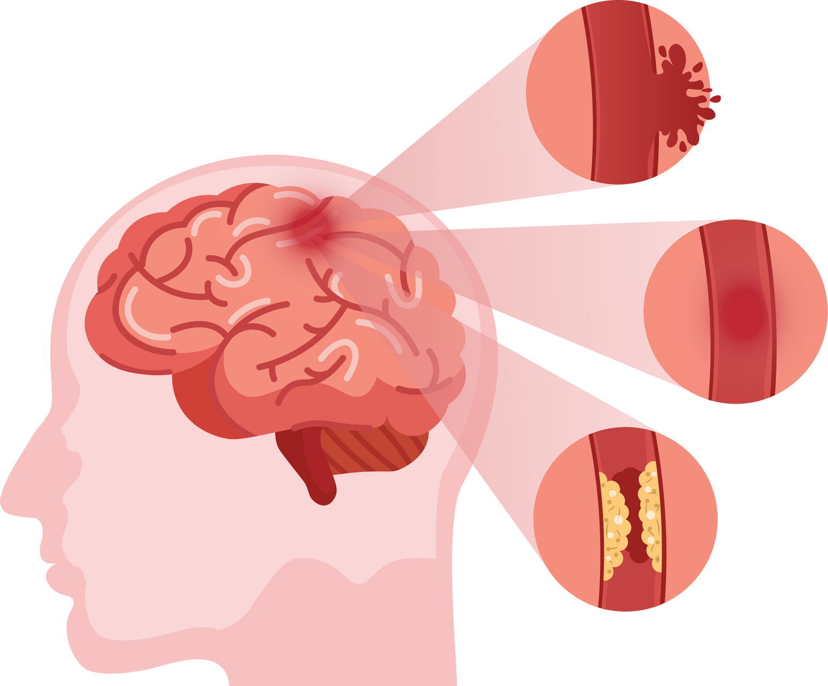
The Cerebros
Shima Roshani, Herthika Sivasuntharampillai & Preston McCabe
Go with the Flow: Rethinking CCA Management with Flow-Diverter Stents
Notes:
This study is part of a broader effort to improve decision-making in aneurysm management, particularly using Flow-Diverter Stents (FDS). I’ll introduce our team, explain the project’s goals, and dive into Dr. Annika Mascarenhas’ research, which focuses on both the natural history of CCAs and treatment options. Let’s begin!"

Slide 2







OUR TEAM
Dr. Mel Boulton
Dr. Annika Mascarenhas
Dr. Alvarado Bolanos
Herthika Sivasuntharampillai
Shima Roshani
Preston McCabe
Supervisor
Fellow
Fellow
IMS MSc Student
IMS MSc Student
IMS MSc Student
Institution: London Health Sciences Centre (LHSC)

Slide 3
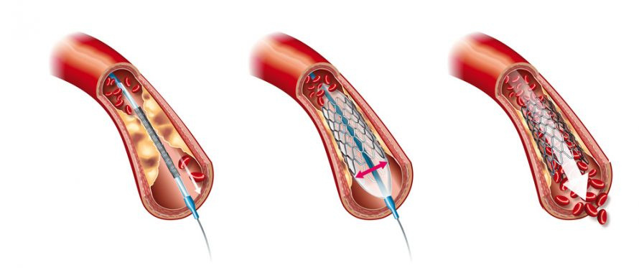
Endovascular Treatments for Aneurysms
  Focus: Investigating treatment options for Cavernous Carotid Aneurysms (CCAs)
  Can cause cranial nerve compression, ischemic events, or rupture
  Conservative vs. Interventional approaches debated
Notes:
thier research focuses on endovascular treatments for Cavernous Carotid Aneurysms (CCAs), a type of aneurysm found in the cavernous segment of the internal carotid artery. Unlike other aneurysms, CCAs typically have a low rupture risk, but they can cause symptoms due to mass effect on cranial nerves, leading to diplopia, facial pain.
Managing these aneurysms is challenging. Some remain stable for years, while others grow and cause symptoms, requiring intervention. Treatment decisions often involve choosing between conservative management (monitoring) or intervention using Flow-Diverter Stents (FDS) or coiling techniques. thier study aims to assess when intervention is necessary and how effective different treatment options are.

Slide 4



Two Key Objectives
Natural History of CCA
Treatment Using FDS
Research Goals
  Understanding how CCAs progress if left untreated
  Identifying risk factors
  Helps determine who needs treatment & when
Treatment of Aneurysms Using Flow-Diverter Stents (FDS)
  Evaluating FDS effectiveness
  Investigating MRI safety of FDS implants
Provide insights for clinicians to decide:
  Which patients require intervention?
  What treatment is best?
  How safe is FDS?
  Improve clinical guidelines for managing CCAs at LHSC
Notes:
Now, let’s focus on their research. They are working on two major projects related to CCAs:
Studying the Natural History of CCAs
This involves tracking the progression of CCAs over time in patients who are not treated. The goal is to determine how often these aneurysms grow, cause symptoms, or remain stable without intervention.
Evaluating Treatment Outcomes Using Flow-Diverter Stents (FDS)
This research examines how well FDS works in treating CCAs. The goal is to identify the best treatment strategies.
The ultimate goal of this research is to improve clinical decision-making in managing CCAs. By understanding:
✅ When to intervene versus when to monitor
✅ Which patients benefit most from Flow-Diverter Stents
✅ The safety and long-term outcomes of these treatments
Their findings will help doctors make evidence-based treatment decisions, improving patient outcomes in LHSC.

Slide 5

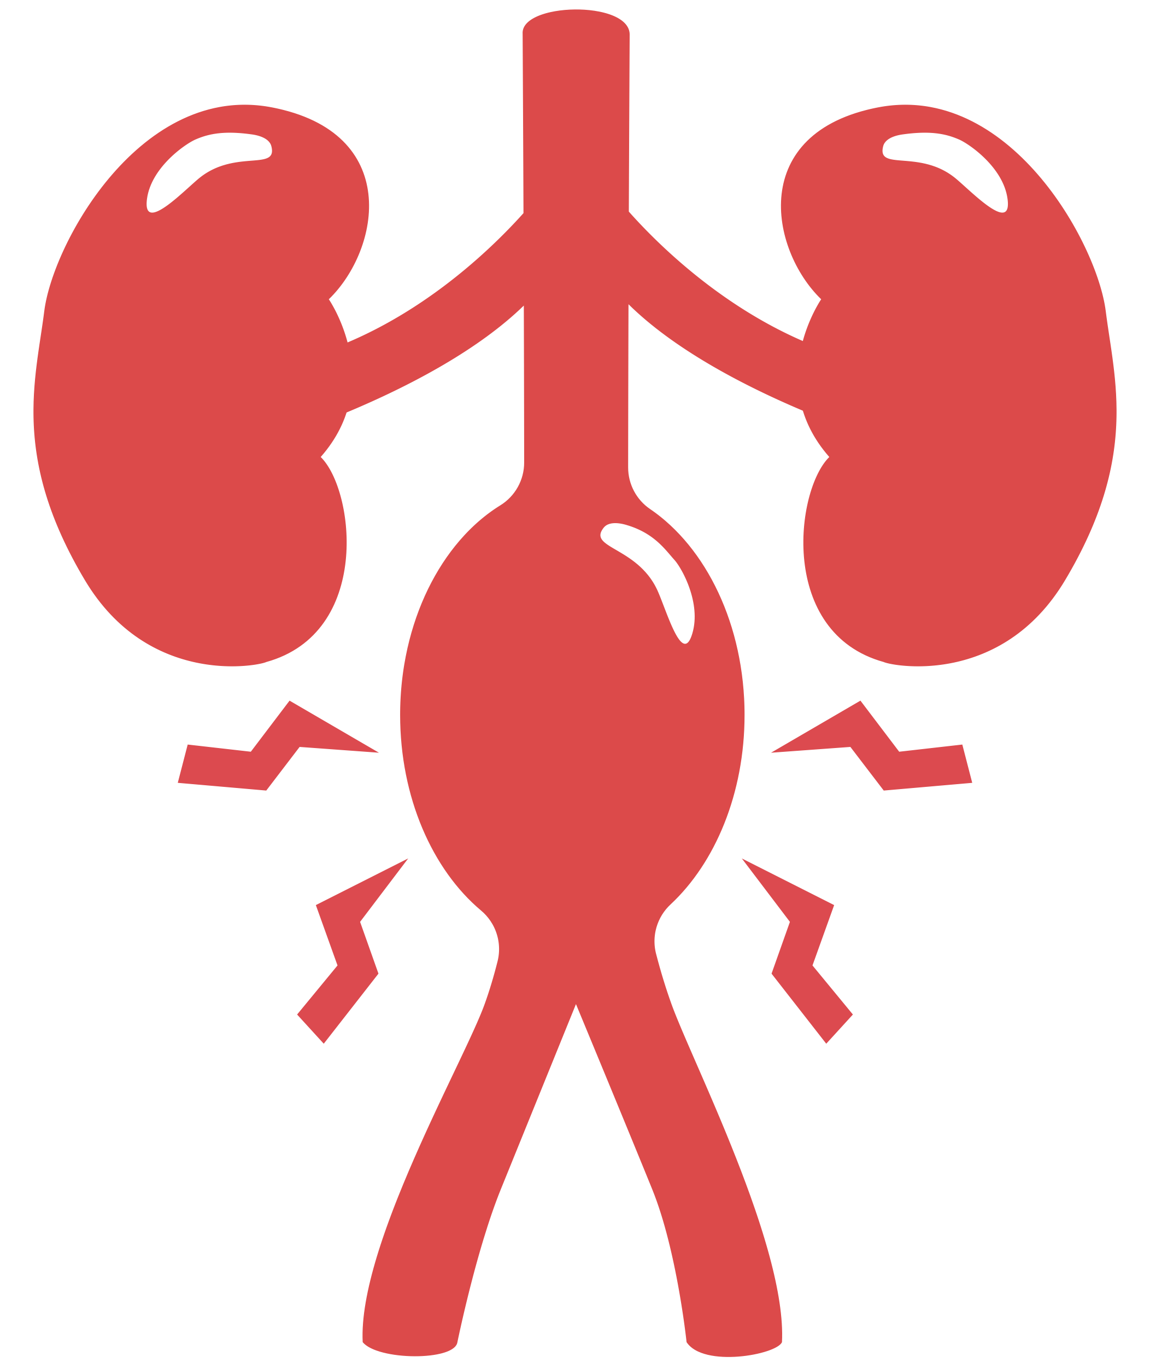
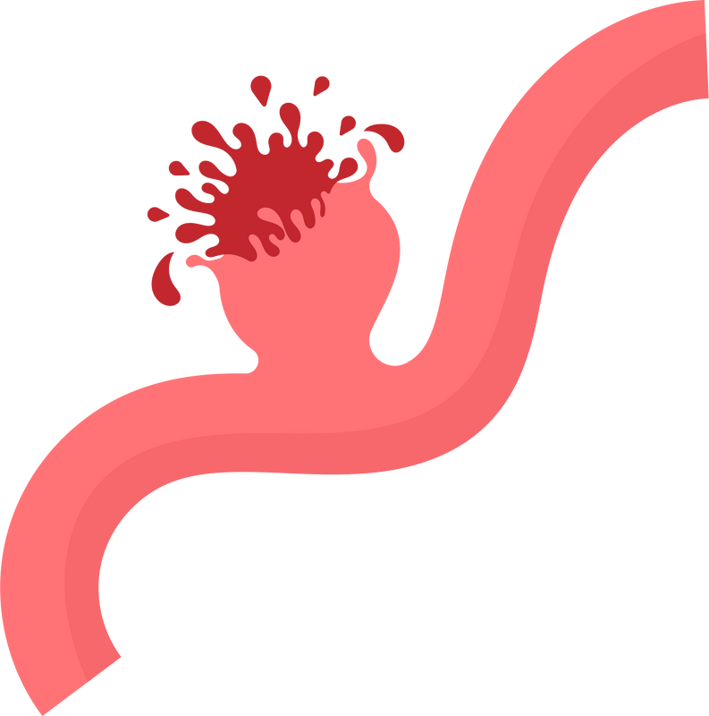
What are Aneurysms ?
Localized, abnormal dilation or bulging of a blood vessel due to a weakened vessel wall
Brain
Aorta
Peripheral Arteries
Notes:
- due to the nature of Annika's research, our observership was heavily based on CCAs and what treatments they used.
- before we get into what CCAs are, I want to take a Quick Look at what aneurysms are

Slide 6
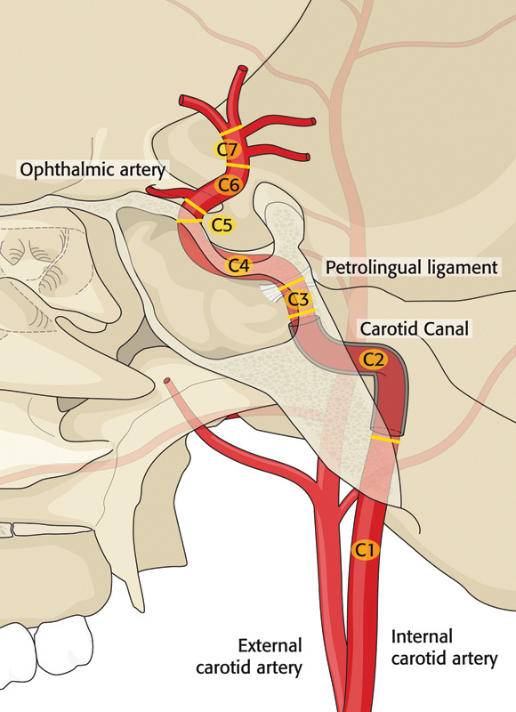
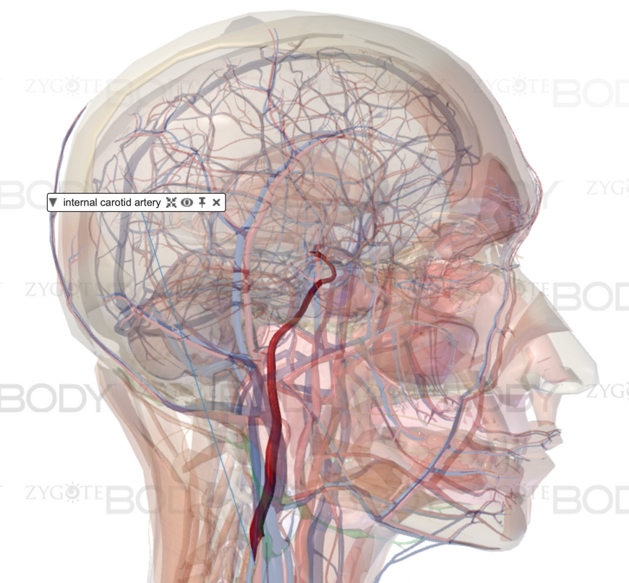
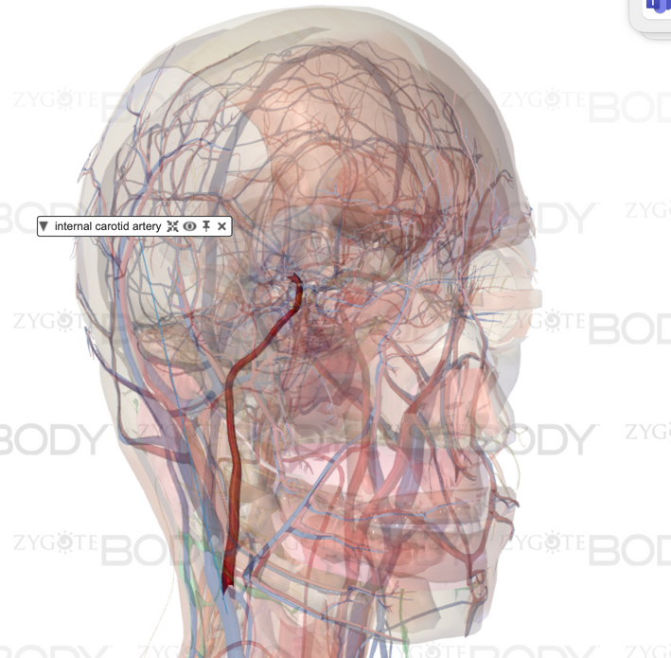
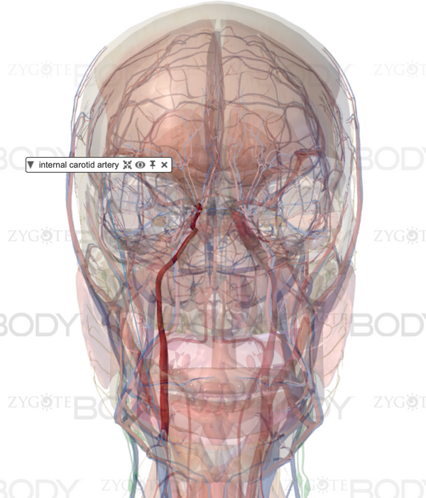


Cavernous Carotid Aneurysm
Canvernous Carotid

Slide 7

Treatment Methods
Conservative Managment
Endovascular Treatment
Surgery
  Small, asymptomatic CCAs
  Regular imaging follow-ups
  Blood pressure control
  Avoidance of blood thinners
  Pain management
  Preferred treatment for symptomatic or growing CCAs.
  FDS
  Coiling
  Reserved for cases where endovascular treatment fails or is not feasible.
  Bypass
  Clipping

Slide 8
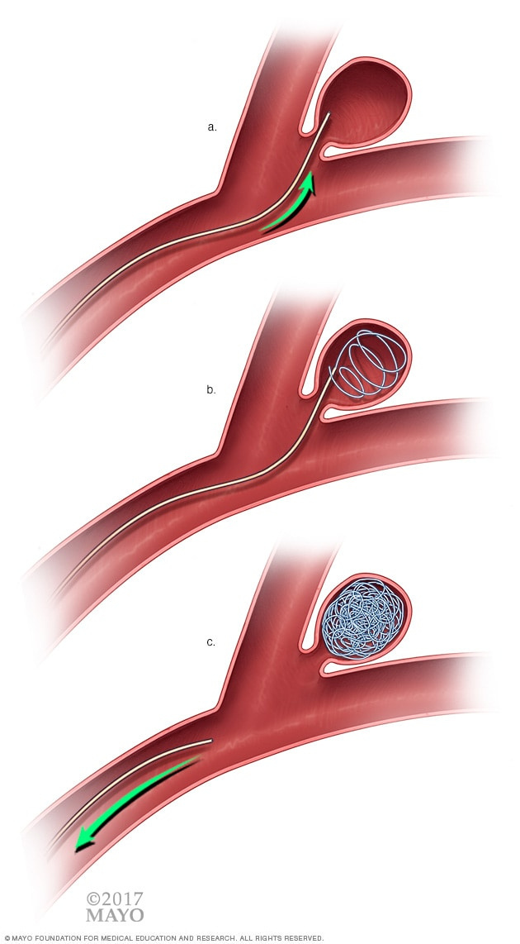
Endovascular Treatment: Coiling
Catheter inserted through femoral artery, using X ray guidance to reach aneurysm
Second micro catheter is guided into aneurysm
Coils are inserted based on size
Coil fills and Catheters are removed
Clotting begins and prevents bloodflow into aneruysm
Notes:
- mention sizing, want to reach 25% capacity?
Step 1: Reaching the Aneurysm (Image a)
A doctor inserts a thin tube (catheter) into a blood vessel, usually in the leg or wrist.
Using X-ray guidance, the tube is carefully moved up through the body until it reaches the brain aneurysm (a bulging, weak spot in a blood vessel).
Step 2: Placing the Coils (Image b)
A second, smaller tube (microcatheter) is guided into the aneurysm.
Tiny soft platinum coils are gently inserted into the aneurysm.
The coils start to form a mesh-like structure inside the bulge.
Step 3: Sealing the Aneurysm (Image c)
The coils fill the aneurysm, causing blood to clot around them.
This clot prevents blood from entering the aneurysm, lowering the risk of rupture.
Once the coils are securely in place, the tubes are removed, and the procedure is done!

Slide 9
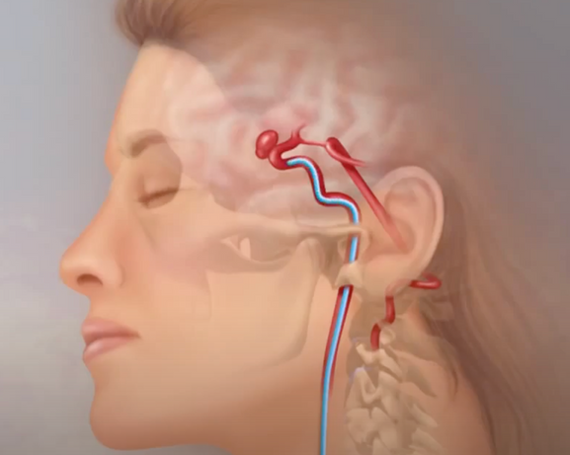
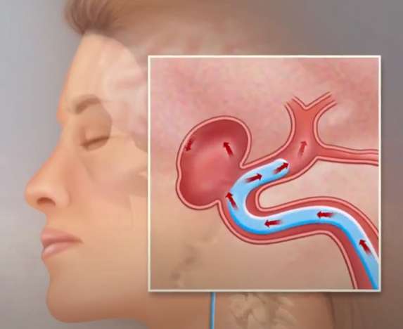
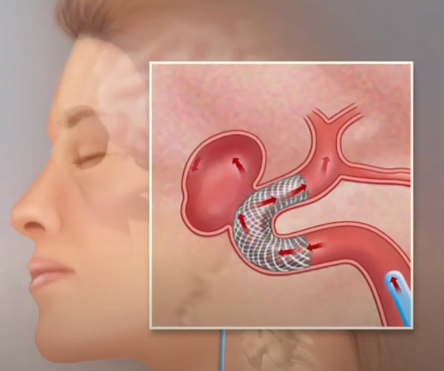
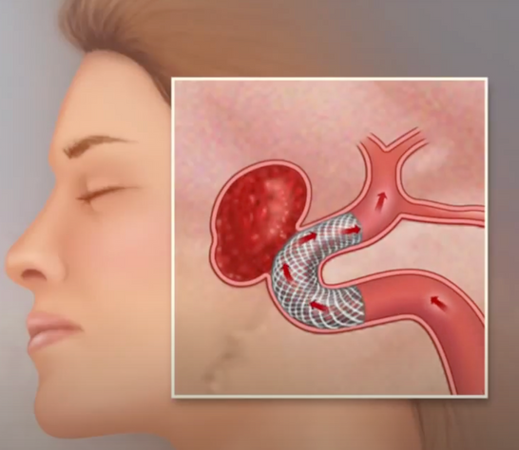
Endovascular Treatment: Flow Diverter Stents (FDS)
Catheter inserted through femoral artery, using X ray guidance to reach aneurysm
The FDS device is carefully placed across the aneurysm’s opening.
Blood flow gradually slows down. 6 months later aneurysms will be closed off and new vessel wall forms

Slide 10


Slide 11


Project & Deliverables
  Flow diverter stent use is still relatively novel, and large scale clinical guidelines remain limited
  This is specifically noted for the decision to treat or manage CCAs - Only 1 meta analysis for natural history
Deliverable 1: A literature review for FDS use on cavernous segment aneuysms
Deliverable 2: A power analysis based on previous literature to outline estimated sample size requirements
Notes:
thier research focuses on endovascular treatments for Cavernous Carotid Aneurysms (CCAs), a type of aneurysm found in the cavernous segment of the internal carotid artery. Unlike other aneurysms, CCAs typically have a low rupture risk, but they can cause symptoms due to mass effect on cranial nerves, leading to diplopia, facial pain, or cavernous sinus syndrome.
Managing these aneurysms is challenging. Some remain stable for years, while others grow and cause symptoms, requiring intervention. Treatment decisions often involve choosing between conservative management (monitoring) or intervention using Flow-Diverter Stents (FDS) or coiling techniques. Our study aims to assess when intervention is necessary and how effective different treatment options are.

Slide 12
Literature Review
Introduction
Methods
Results
  Limited data availability for FDS use on CCAAs.
  Supported their original literature search and found similar gap in the literature
  Searched Pubmed Google Scholar
  Terms such as “CCAA”, “Cavernous Segment”,”flow diversion”, “Pipeline device”
  Found 18 new papers for the literature review
  Most papers pointed to the efficacy of FDS use, often favouring their use over other methods
  Most studies however had small samples (<30), short follow up periods, and often did not compare FDS to other treatments
Notes:
Conservative management
- Small, asymptomatic CCAs that do not show significant growth or symptoms.
Regular imaging follow-ups to monitor growth.
Blood pressure control with antihypertensive medications.
Avoidance of blood thinners (unless necessary) to reduce rupture risk.
Pain management if cranial nerve compression occurs.
Endo treatment
Endovascular approaches are the preferred treatment for symptomatic or growing CCAs.
FDS or Coiling

Slide 13
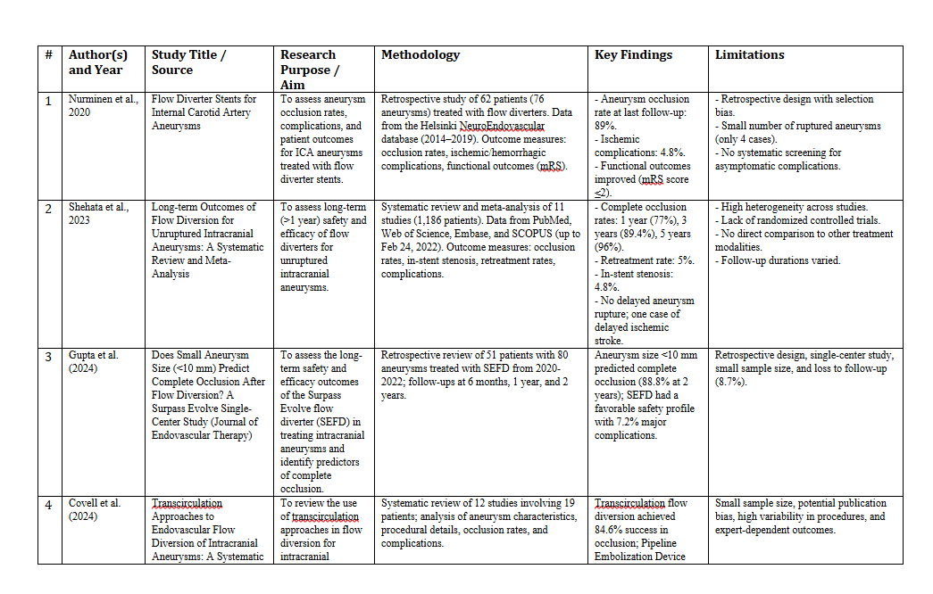
Literature Review Table

Slide 14

Power Analysis
Introduction
Methods
Results
  An estimated 800 records in the LHSC database for patients with a CCA and/or treated with FDS for any aneurysm
  Unknown power to evaluate specific treatment comparisons
  G*Power used to estimate minimum power detectable with sample
  Prior research on symptom improvement was used to estimate effect sizes between treatments and natural history
  Calculated estimated sample sizes required in best-case, moderate, and conservative scenarios
  We found that the overall power should be sufficient for comparing natural history to different types of treatment
  some treatment comparisons may be difficult such as coiling compared to stent assisted coiling or FDS to surgical techniques
Notes:
Conservative management
- Small, asymptomatic CCAs that do not show significant growth or symptoms.
Regular imaging follow-ups to monitor growth.
Blood pressure control with antihypertensive medications.
Avoidance of blood thinners (unless necessary) to reduce rupture risk.
Pain management if cranial nerve compression occurs.
Endo treatment
Endovascular approaches are the preferred treatment for symptomatic or growing CCAs.
FDS or Coiling

Slide 15
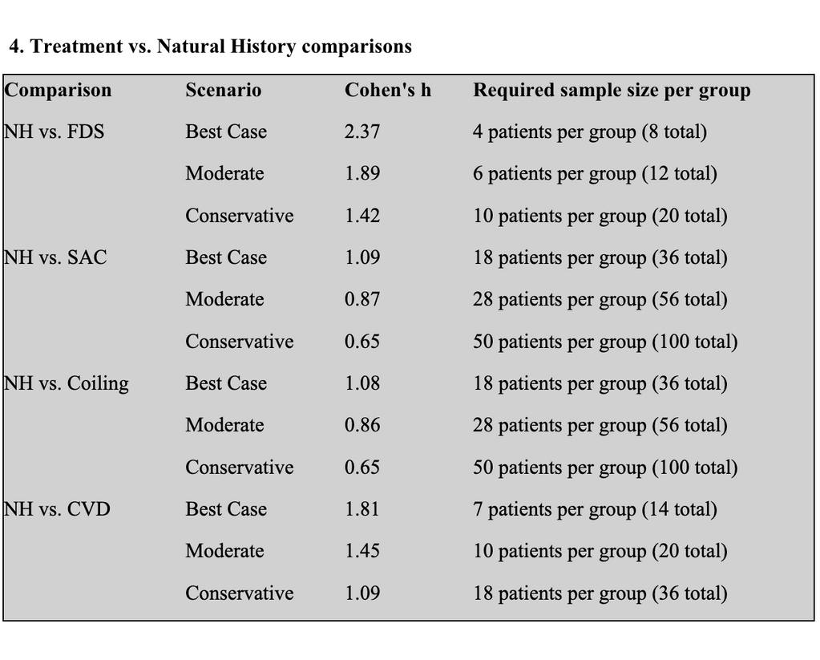
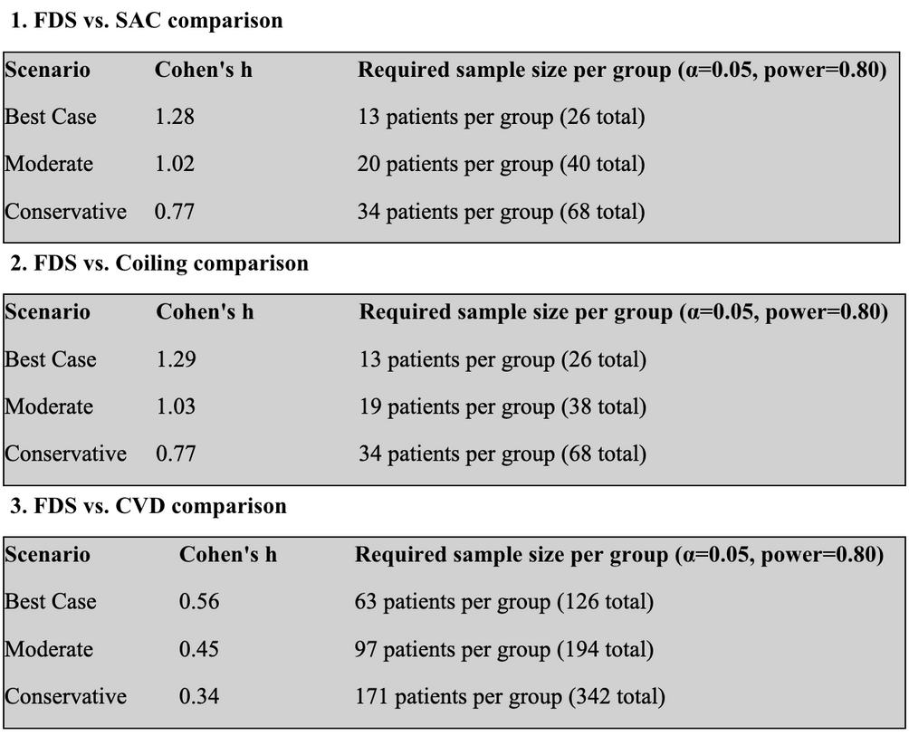
Power Analysis Summary

Slide 16



Conclusion: What We Learned
01
02
03
Importance of Evidence-Based Decision-Making
Literature Review & Research Insights
  Reviewing studies on treatment effectiveness and patient outcomes.
  Identifying gaps in current knowledge
Observership Experience
  We observed real-world cases of patients treated with FDS and coiling.
Notes:
To summarize, this rotation has reinforced the importance of evidence-based decision-making in treating patients. By reviewing the natural history of patients, we can better determine when intervention is necessary. The literature review has provided insights into the effectiveness of Flow-Diverter Stents.
Additionally, through observership, we had the opportunity to see real-world cases of patients undergoing FDS and coiling treatments. This hands-on experience allowed us to witness the challenges and considerations in making treatment decisions.

Slide 17
Thank You!
Special thank you to Dr. Mel Boulton, Dr. Alonso Alvarado Bolanos, Dr. Annika Mascarenhas, and the rest of the Neuro-Angio Team!

